Slide 1
Practical ORMs
Juozas “Joe” Kaziukėnas, 2010

Slide 2
Who am I?
Juozas Kaziukėnas, Lithuanian
You can call me Joe
2 years in Edinburgh, UK
Studying in University of Edinburgh
Software developer at 4c, inc. and UAB “Barzda”
Open source developer for Zend Framework and Doctrine
More info in www.juokaz.com and twitter @juokaz

Slide 3

ORMs!!!?

Slide 4
5 years ago…
“old-style” PHP
SQL everywhere
Hard to understand
No migrations possible
Not OOP
At least not for database interactions

Slide 5

5 years ago…

Slide 6
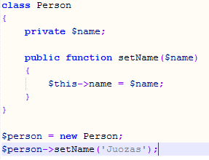
OOP
Everyone (should have) learnt it at school/university

Slide 7

Object relational mapping

Slide 8
Object relational mapping
Mapping
PHP objects == database rows
OOP all the way!
Database
Functionality
Features
Implications
Design

Slide 9
Models
Properties
Behaviour
Business logic
Application layer M (from MVC)

Slide 10
Relations
User
Blog posts
Comments
Pingbacks
Groups
Moderators

Slide 11
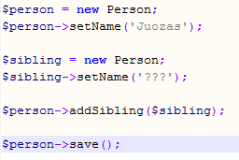
Relations OOP style
One-to-one, many-to-one, many-to-many

Slide 12
Querying
Different than SQL
DQL in Doctrine
Working with models, not tables
SELECT * FROM Model_Blog B WHERE B.id = 1
Very complicated internals
Database driver specific functionality

Slide 13
Database servers
Works with all of them
I’m contributing Microsoft SQL server support to Doctrine
Abstracted access – migrations are possible
Different databases for different environments

Slide 14

Speed

Slide 15
Speed
Hydration (from SQL results to objects)
SQL optimization
Memory usage
Lots of classes and very complicated underlying code

Slide 16

Other issues

Slide 17
Other issues
Application architecture
Partitioning models
Lots of small classes
Doesn’t work for all projects

Slide 18

Why do I need all this?

Slide 19
Why do I need all this?
Faster coding
“Logical” application
Clear business logic
Standards
Not limited to databases
... Much more

Slide 20
I want to try it!
PHP implementations:
Doctrine (and Doctrine 2.0)
Propel
A few more
Lots of people at #doctrine
Used in production today

Slide 21
Questions
Want to know more?
www.juokaz.com – my website
dev.juokaz.com – my blog
@juokaz twitter
Thanks!

